Slide 1
CTL019 cell
Cellular Immunotherapy with CAR T cells Engineering
Lentiviral vector
Native TCR
Anti-CD19
CAR construct
CD19
Dead tumor cell
CAR T Cell Toxicity Management in Acute Leukemia
Shannon Maude, MD PhD
Cancer Immunotherapy Program
Children’s Hospital of Philadelphia
The University of Pennsylvania School of Medicine
CAR-T and the Rise of Cellicon Valley
May 10, 2019

Slide 2
Disclosures
Consultancy:
– Novartis: advisory boards, clinical trial development
– Kite: advisory board
CTL019 (now known as Kymriah, tisagenlecleucel) licensed by Novartis
CTL119 (investigational product) licensed by Novartis
KTE-C19 (now known as Yescarta, axicabtagene ciloleucel) licensed by Kite

Slide 3
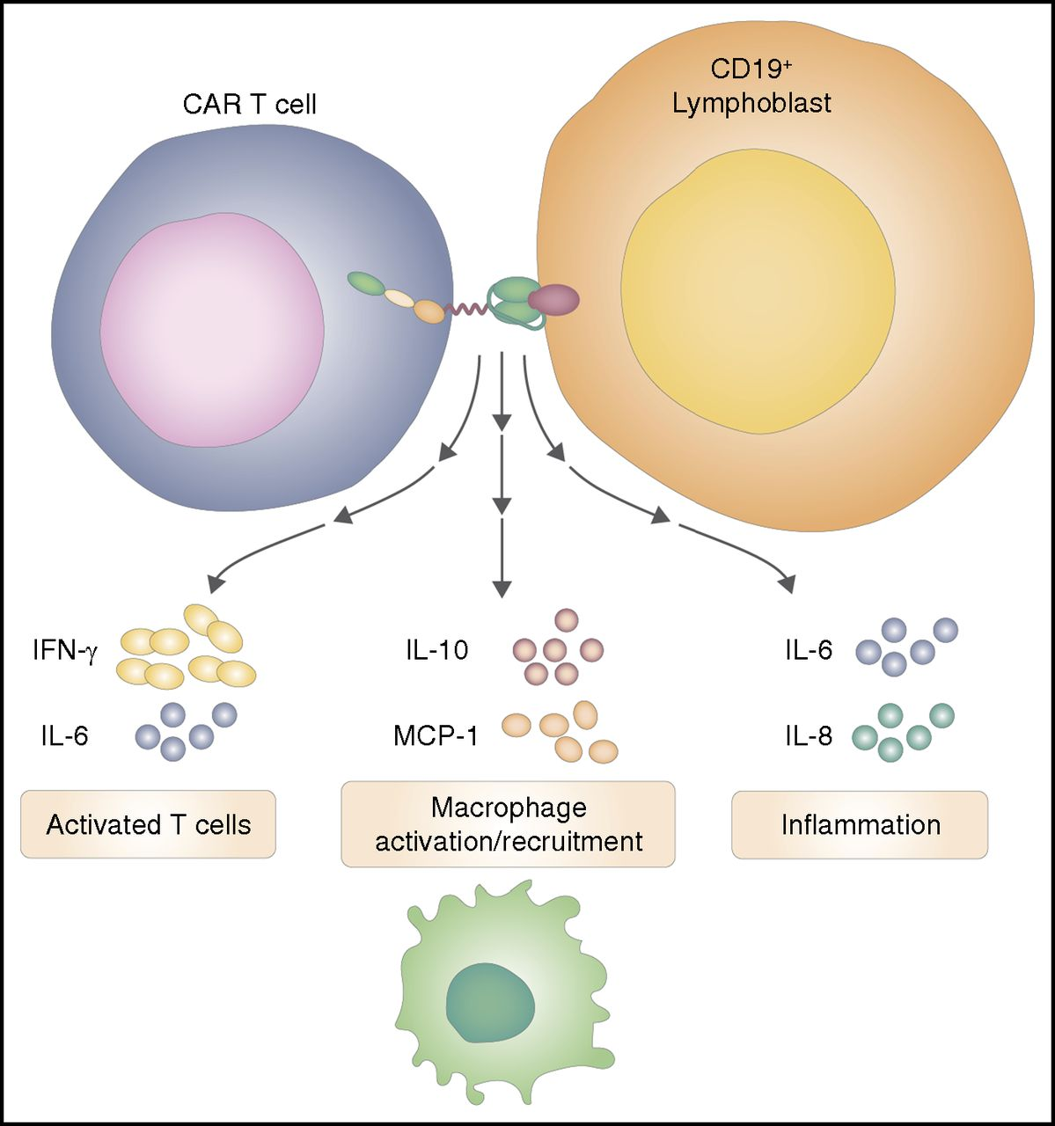
Toxicities of CAR T Cells Targeting B-ALL
Acute:
CRS
Neurotoxicity
Cytopenias
Chronic:
B cell aplasia
Cytopenias
Theoretical:
Integrational mutagenesis
Secondary malignancies
Maude SL. Blood 2017;130:2238-2240

Slide 4
Cytokine Release Syndrome
CRS is constellation of signs/symptoms related to exponential T cell expansion and elevations in cytokines
Symptoms typically occur 1-14 days after CAR T cell infusion in ALL and progress over the course of days
Hypotension
Respiratory insufficiency
Renal insufficiency
Coagulopathy
Fever
Myalgias
Nausea/Vomiting
Severity scales with disease burden

Slide 5
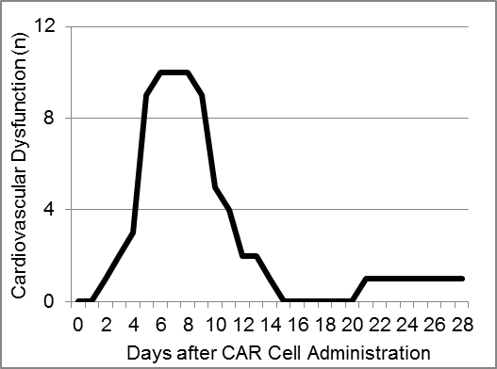
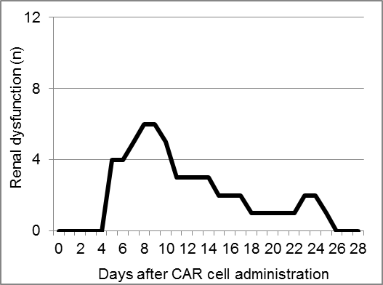
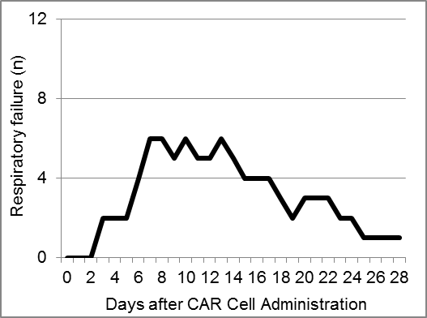
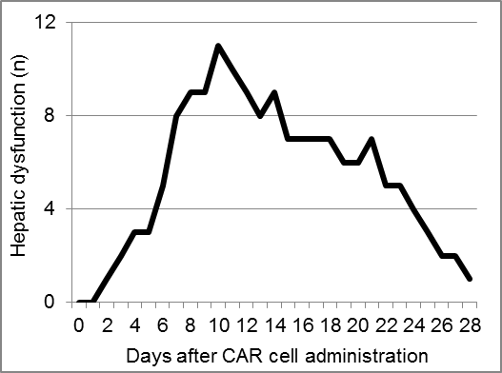
Clinical manifestations of severe CRS
Fitzgerald JC, et al. Crit Care Med. 2016;44(12):2241-2250.

Slide 6
Severe CRS mimics HLH/MAS
CRS symptoms:
Systemic inflammatory response with vascular leak, hypotension, respiratory and renal insufficiency
HSM, Transaminitis, Hyperbilirubinemia
Coagulopathy
Marked by low fibrinogen
Extraordinarily high ferritin levels
16,000 to 415,000 ng/ml
Mitigated with cytokine blockade
IL-6R blocking agent tocilizumab
Requires close monitoring and cryo replacement

Slide 7
CRS Management Algorithm
Pretreatment
Acetaminophen/paracetamol and diphenhydramine/H1 antihistamine
Prophylaxis for complications of tumor lysis syndrome (TLS) as appropriate
CTL019 Infusion
Prodromal syndrome: low-grade fevers, fatigue, anorexia (hours to days)
Management: Observation, rule out infection (surveillance cultures); antibiotics per local guidelines (febrile neutropenia); symptomatic support
Prodromal syndrome: low-grade fevers, fatigue, anorexia (hours to days)
Management: Observation, rule out infection (surveillance cultures); antibiotics per local guidelines (febrile neutropenia); symptomatic support
Symptom progression:
High fevers, hypoxia, mild hypotension
First-Line Management: Oxygen, fluids, low-dose vasopressor support, antipyretics; monitor/manage complications of TLS
Further symptom progression
Hemodynamic instability despite IV fluids and moderate- to “high-dose”ª vasopressor support OR
Worsening respiratory distress, including pulmonary infiltrates increasing oxygen requirement including high-flow oxygen and/or need for mechanical ventilation OR
Rapid clinical deterioration
Second-Line Management
Tocilizumab: IV infusion over 1 hour (patient weight < 30 kg: 12 mg/kg IV; patient weight ≥ 30 kg: 8 mg/kg IV [maximum dose 800 mg])
Hemodynamic and respiratory support
First manifestation of CRS:
Flu-like symptoms starting within 24 hours to 7-14 days
☞ Treat symptomatically
ª See definition of “high-dose” vasopressors.
Continued on next slide

Slide 8
CRS Management Algorithm
Pretreatment
Acetaminophen/paracetamol and diphenhydramine/H1 antihistamine
Prophylaxis for complications of tumor lysis syndrome (TLS) as appropriate
CTL019 Infusion
Prodromal syndrome: low-grade fevers, fatigue, anorexia (hours to days)
Management: Observation, rule out infection (surveillance cultures); antibiotics per local guidelines (febrile neutropenia); symptomatic support
Symptom progression:
High fevers, hypoxia, mild hypotension
First-Line Management: Oxygen, fluids, low-dose vasopressor support, antipyretics; monitor/manage complications of TLS
Symptom progression:
High fevers, hypoxia, mild hypotension
First-Line Management: Oxygen, fluids, low-dose vasopressor support, antipyretics; monitor/manage complications of TLS
Further symptom progression
Hemodynamic instability despite IV fluids and moderate- to “high-dose”ª vasopressor support OR
Worsening respiratory distress, including pulmonary infiltrates increasing oxygen requirement including high-flow oxygen and/or need for mechanical ventilation OR
Rapid clinical deterioration
Second-Line Management
Tocilizumab: IV infusion over 1 hour (patient weight < 30 kg: 12 mg/kg IV; patient weight ≥ 30 kg: 8 mg/kg IV [maximum dose 800 mg])
Hemodynamic and respiratory support
Progression of CRS:
Vascular leak starting 2-5 days after fever onset leading to hypotension and fluid overload
☞ Fluids (limited), oxygen
Unstable hypotension, not
immediately responsive to fluids:
☞ Start low-dose pressors, consider toci
ª See definition of “high-dose” vasopressors.
Continued on next slide

Slide 9
CRS Management Algorithm
Further progression despite supportive care:
Escalation of pressor or respiratory support
☞ Tocilizumab
Pretreatment
Acetaminophen/paracetamol and diphenhydramine/H1 antihistamine
Prophylaxis for complications of tumor lysis syndrome (TLS) as appropriate
CTL019 Infusion
Further symptom progression
Hemodynamic instability despite IV fluids and moderate- to “high-dose”ª vasopressor support OR
Worsening respiratory distress, including pulmonary infiltrates increasing oxygen requirement including high-flow oxygen and/or need for mechanical ventilation OR
Rapid clinical deterioration
Second-Line Management
Tocilizumab: IV infusion over 1 hour (patient weight < 30 kg: 12 mg/kg IV; patient weight ≥ 30 kg: 8 mg/kg IV [maximum dose 800 mg])
Hemodynamic and respiratory support
Prodromal syndrome: low-grade fevers, fatigue, anorexia (hours to days)
Management: Observation, rule out infection (surveillance cultures); antibiotics per local guidelines (febrile neutropenia); symptomatic support
Symptom progression:
High fevers, hypoxia, mild hypotension
First-Line Management: Oxygen, fluids, low-dose vasopressor support, antipyretics; monitor/manage complications of TLS
Further symptom progression
Hemodynamic instability despite IV fluids and moderate- to “high-dose”ª vasopressor support OR
Worsening respiratory distress, including pulmonary infiltrates increasing oxygen requirement including high-flow oxygen and/or need for mechanical ventilation OR
Rapid clinical deterioration
Second-Line Management
Tocilizumab: IV infusion over 1 hour (patient weight < 30 kg: 12 mg/kg IV; patient weight ≥ 30 kg: 8 mg/kg IV [maximum dose 800 mg])
Hemodynamic and respiratory support
ª See definition of “high-dose” vasopressors.
Continued on next slide

Slide 10
CRS Management Algorithm
Lack of clinical improvement while awaiting tocilizumab response
Third-Line Management
Consider other diagnosis causing clinical deterioration (ie, sepsis, adrenal insufficiency)
If no improvement with first dose of tocilizumab within 12 to 18 hours, consider steroids (plan rapid taper after hemodynamic normalization): 2 mg/kg methylprednisolone as an initial dose, then 2 mg/kg per day; as steroids are tapered quickly, monitor for adrenal insufficiency and need for hydrocortisone replacement
If no response to steroids within 24 hours, consider second dose of tocilizumab (dose as above)
Hemodynamic and respiratory support
Lack of clinical improvement while awaiting tocilizumab response
Third-Line Management
Consider other diagnosis causing clinical deterioration (ie, sepsis, adrenal insufficiency)
If no improvement with first dose of tocilizumab within 12 to 18 hours, consider steroids (plan rapid taper after hemodynamic normalization): 2 mg/kg methyl-prednisolone as an initial dose, then 2 mg/kg per day; as steroids are tapered quickly, monitor for adrenal insufficiency and need for hydrocortisone replacement
If no response to steroids within 24 hours, consider second dose of tocilizumab (dose as above)
Hemodynamic and respiratory support
Lack of clinical improvement while awaiting response to third-line management
Fourth-Line Management
Consider other diagnosis causing clinical deterioration (ie, sepsis, adrenal insufficiency)
If no response to steroids and second dose of tocilizumab within 24 hours or further clinical deterioration, consider siltuximab 11 mg/kg IV over 1 hour
Hemodynamic and respiratory support
Lack of clinical improvement while awaiting response to fourth-line management
Fifth-Line Management
Consider other diagnosis causing clinical deterioration (ie, sepsis, adrenal insufficiency)
If ongoing CRS despite prior therapy, consider anti–T-cell therapies such as cyclophosphamide, anti-thymocyte globulin, or alemtuzumab
Hemodynamic and respiratory support
Transient or insufficient response to toci (12-18h):
Unable to wean pressors
☞ Steroids
Still no improvement (24h):
Unable to wean pressors + fever
☞ Second toci

Slide 11
CRS Management Algorithm
Lack of clinical improvement while awaiting tocilizumab response
Third-Line Management
Consider other diagnosis causing clinical deterioration (ie, sepsis, adrenal insufficiency)
If no improvement with first dose of tocilizumab within 12 to 18 hours, consider steroids (plan rapid taper after hemodynamic normalization): 2 mg/kg methylprednisolone as an initial dose, then 2 mg/kg per day; as steroids are tapered quickly, monitor for adrenal insufficiency and need for hydrocortisone replacement
If no response to steroids within 24 hours, consider second dose of tocilizumab (dose as above)
Hemodynamic and respiratory support
Lack of clinical improvement while awaiting response to third-line management
Fourth-Line Management
Consider other diagnosis causing clinical deterioration (ie, sepsis, adrenal insufficiency)
If no response to steroids and second dose of tocilizumab within 24 hours or further clinical deterioration, consider siltuximab 11 mg/kg IV over 1 hour
Hemodynamic and respiratory support
Lack of clinical improvement while awaiting response to third-line management
Fourth-Line Management
Consider other diagnosis causing clinical deterioration (ie, sepsis, adrenal insufficiency)
If no response to steroids and second dose of tocilizumab within 24 hours or further clinical deterioration, consider siltuximab 11 mg/kg IV over 1 hour
Hemodynamic and respiratory support
Lack of clinical improvement while awaiting response to fourth-line management
Fifth-Line Management
Consider other diagnosis causing clinical deterioration (ie, sepsis, adrenal insufficiency)
If ongoing CRS despite prior therapy, consider anti–T-cell therapies such as cyclophosphamide, anti-thymocyte globulin, or alemtuzumab
Hemodynamic and respiratory support
Insufficient response to 2nd toci (24h):
Unable to wean pressors + fever
☞ Siltuximab

Slide 12
Neurotoxicity
Symptoms
Confusion/delirium
Expressive aphasia
Global encephalopathy
Tremor
Seizure
Management
Supportive care/seizure management
Steroids?
Pathophysiology
Cytokine-mediated?

Slide 13
CAR T cell Engineering
T cell
Acute:
CRS
Neurotoxicity
Cytopenias
CAR T cell
Native TCR
Chronic:
B cell aplasia
Cytopenias
Anti-CD19
CAR construct
CD19
Theoretical:
Integrational mutagenesis
Secondary malignancies
Dead B cell
Normal/
Malignant
B cell

Slide 14
On-Target Toxicity
B cell aplasia
70-80% treated with persistent CD19 CAR at risk for chronic B cell aplasia
Maude SL et al. N Engl J Med 2018;378:439-448

Slide 15
B cell aplasia
Management:
Immunoglobulin replacement
Required in peds
Possibly not in adults?
Subcutaneous immunoglobulin for chronic B cell aplasia
Monitor IgG
Monitor for chronic sinusitis

Slide 16
Persistent Cytopenias
ELIANA Safety: AE of special interest (AESI)
Maude SL et al. N Engl J Med 2018;378:439-448

Slide 17
CAR T cell Engineering
T cell
Acute:
CRS
Neurotoxicity
Cytopenias
Lentiviral vector
Native TCR
Chronic:
B cell aplasia
Cytopenias
CD19
Theoretical:
Integrational mutagenesis
Secondary malignancies
Normal/
Malignant
B cell

Slide 18
Theoretical Concerns
Secondary Malignancies
Insertional Mutagenesis
Experience to date has not shown this (Scholler J et al. Sci Transl Med. 2012;4(132):132ra153; Biffi A et al., Blood. 2011;117(20):5332-5339)
Secondary to chronic B cell aplasia
GVHD
Autoimmunity
?Unknown

Slide 19
Perspective
CD19 CAR
B cell aplasia
Hypogammaglobulinemia
Infection
?Secondary malignancy
?Unknown
Standard ALL therapy
Infection
Cardiomyopathy
Metabolic syndrome
Learning disabilities
Decrease in IQ
Osteonecrosis
Secondary malignancy
SCT with TBI adds
GVHD
Infection
Endocrinopathies
Pulmonary complications
Further decrease in IQ
Growth delay
Infertility

Slide 20
Penn CCI
Carl June
Anne Chew
Regina Young
CHOP Cancer Immunotherapy Program
Stephan Grupp
Shannon Maude
Amanda DiNofia
Lisa Wray
Allison Leahy Sue Rheingold
Colleen Callahan
Diane Baniewicz
Amy Barry
Penn Clinical
David Porter
Noelle Frey
CHOP Nursing
CTO/IND Office
CHOP Stem Cell Lab
Yongping Wang
CHOP Vector Core
Frasier Wright
CVPF
Bruce Levine
Don Siegel
Andrew Fesnak
Penn Statistics
Pamela Shaw
Ann Tierney
Patients and Families
Adaptive TcR
TCSL
Simon Lacey
Jeff Finklestein
Farzana Nazimuddin
Vanessa Gonzalez
Grupp Lab
David Barrett
David Teachey
Alix Seif

